Slide 1

Data Visualization With R
Akwijoro Elijah Rona
Twitter: @Elijah_Rona
LinkedIn: Elijah Akwijoro
GitHub: elijahrona
Email: elijahakwijoro@gmail.com

Slide 2
Table of Contents
• Introduction to R: Why R? • Necessary R Packages for Visualization • Visualization and Basic Dashboards with Ggplot2. • Introduction to RShiny • Conclusion

Slide 3
Why R?
Awesome language for Data Analysis
Multiple libraries to match your needs
Comes with Sample dataset (data())
Very easy to understand
Awesome international community

Slide 4
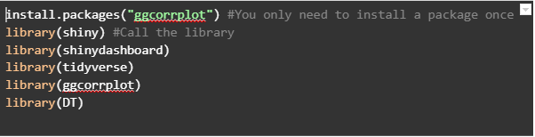
Popular Visualization Packages in R
Tidyverse: Everything to wrangle and visualize datasets including ggplot2 and dplyr.
Patchwork: To combine plots to make a basic (static) dashboard.
Ggcorrplot: Use to make a correlation plot
Shiny: For interactive dashboards.
Shinydashboard: Themes for shiny dashboards

Slide 5
Visualization and Basic Dashboards with Ggplot2
With ggplot2, you can make any type of chart. Examples are:
Bar charts
Line charts
Box plots
Heatmaps
GIS maps
Note: You do not need to call library(ggplot2) if you have already called library(tidyverse).

Slide 6
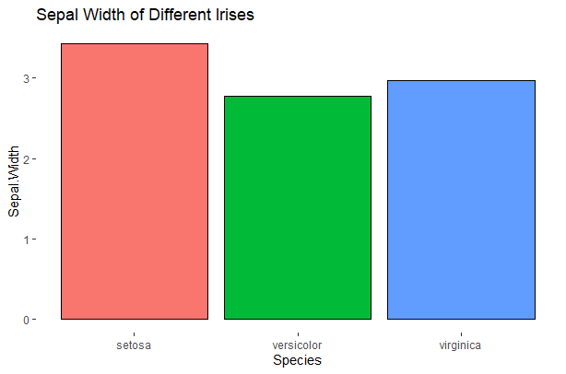
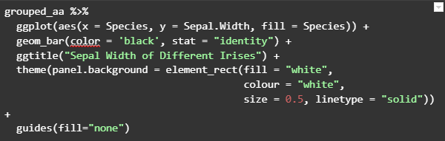
Bar Charts
Use bar charts to compare discrete variables in the x axis to continuous variables in the y axis. You can also create clustered bars in which each discrete variables in the x axis have a number of bars in a group.

Slide 7
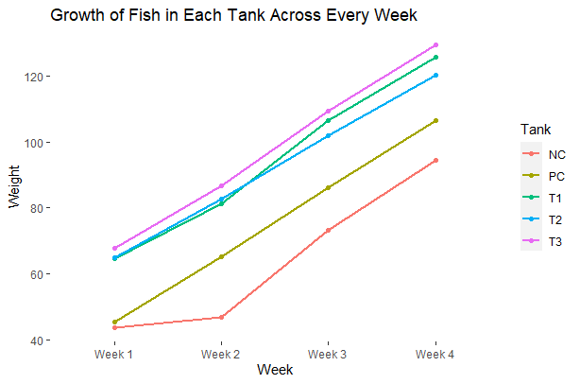
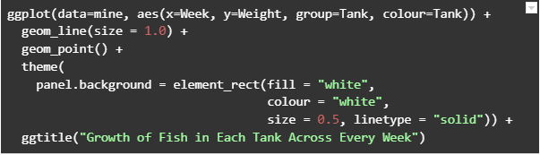
Line Charts
Lines are similar to bars, as they need similar types of variables in their x and y axes. However line charts deal with progression while making comparison. This means that the x axis should indicate weeks, years, days, or anything we can measure progress with.

Slide 8
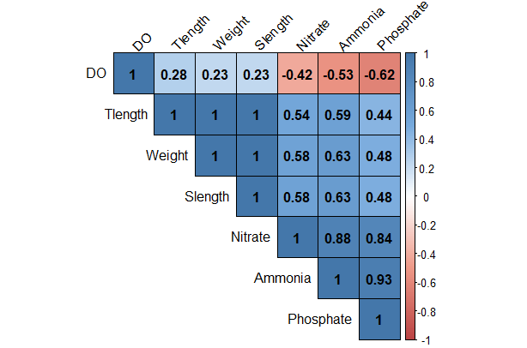
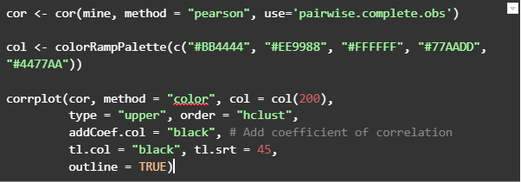
Correlation Plots
Use correlation plots to find the relationship between two or more continuous variables. If the correlation value is positive and close to 1, it is a positive relationship which means that one value increases as the other increases. If the value is negative and close to -1, it is a negative relationship which means that one value decreases as the other increases. If the value is positive or negative but very close to 0, it is a neutral relationship and the increase of one does not determine the increase or decrease of another.

Slide 9
Basic (Static) Dashboards
You can create a combination of plots with either patchwork or ggarrange libraries. You only need to save the plots as variables so that you can call them.
In patchwork:
+ signifies columns
/ signifies rows
Variables in brackets () are together and can be mixed with others. For example, (p1+p2)/p3 means two rows in which the first row is split into two columns while the second row is a single plot.

Slide 10
Introduction to R Shiny
Create a complex WebApp with interactive plots and other functions. For example, you can collect inputs from the app and the app will automatically generate new plots.
You can do anything in R Shiny. You can even deploy your machine learning models with it!!!

Slide 11
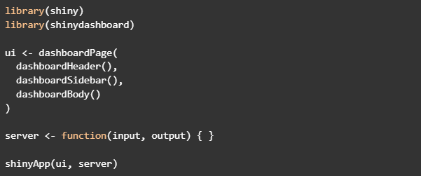
Blank App

Slide 12
Titles and Boxes
Boxes are the building blocks of the web app. You can put whatever you want in a box. Boxes are not compulsory, as you can build apps without them. However, they help to arrange your app in a well-defined manner.
Boxes can be collapsible and have any color of your choice. Also, you can change their height or width according to your desire.
NOTE THAT WIDTH IS COLUMN-BASED WHILE HEIGTH IS PIXEL-BASED.

Slide 13
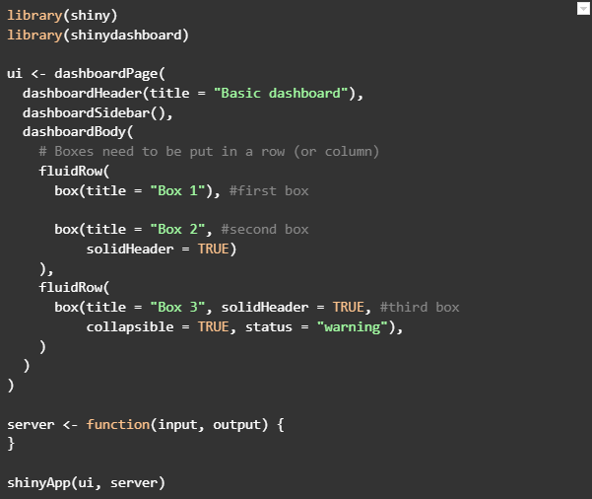
App Title
First plain box
Second box with
Collapsible header
Third box with collapsible header and different color

Slide 14

Box Colors
Using the “status =“ argument, you can change the colors of boxes. Here are the available colors in the shinydashboard library. There more options in other libraries such as shinythemes.

Slide 15
Inserting Plots into Boxes
To insert plots into boxes, you need to work in both the UI and Server parts of the app. Before, you were working in just the UI. Now, time to go to the server.
In the Server part of the app you will create the plot and store it in a renderplot({}) function. In the UI part of the app, you will call the plot. Remember to give your plots different (unique) tags.
You must remember to insert every library, function, and data used in making the chart in the server part of the app. To be certain of not making any mistakes, clear your R environment.

Slide 16
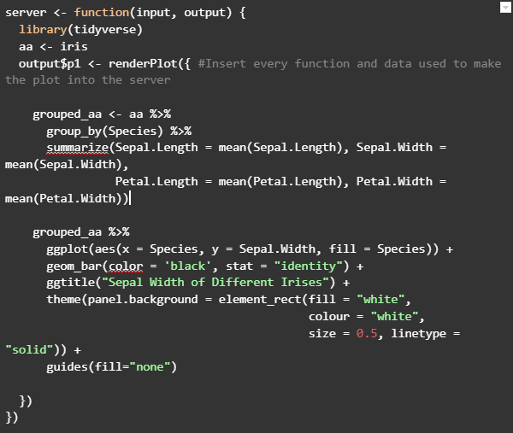
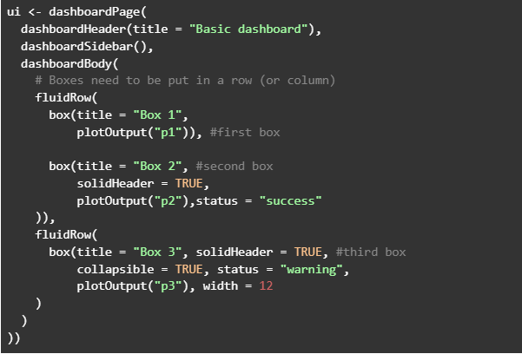
Server
UI

Slide 17
Key Performance Indicators (KPI)
Key performance indicators can be static or dynamic, according to what you want. Static boxes can be created in UI alone. For dynamic boxes, they must be created in both the UI and Server parts of the app.
You can change their colors with “color =“ and their icons with “icon =“. For the icon names, visit https://fontawesome.com/v4/icons/.

Slide 18
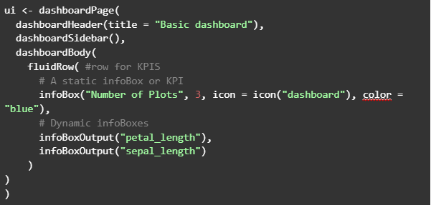
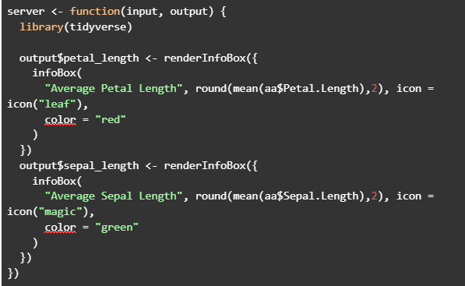
Server
UI

Slide 19
Tabs
The Rshiny WebApp can be split into multiple tabs. This means that you can have multiple reports in a single app. It means that you can do a combination too many things because you can do anything in every tab. Tabs can also have icons.
Everything about tabs is handled in the UI part. However, you will work in both sidebarMenu() and dashboardBody() parts of the UI. The sidebarMenu() will contain the list of the tabs (or menu) while the dashboardBody() will contain the contents of each tab.
The “tabName =“ argument is the tag of each tab. You use this tag to call the tab.

Slide 20
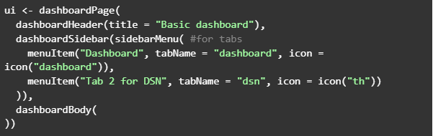
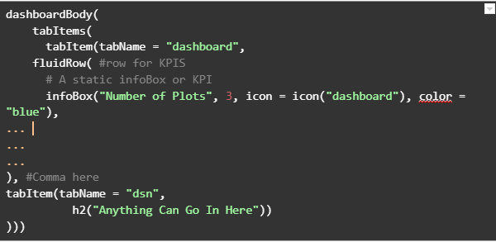
Tabs are menuItems in the dashboardSidebar
Tabs are called in the dashboardBody with their tabName

Slide 21
Your Personal Project and an Assignment
Open a fresh Shiny App script by clicking “New File” in RStudio and then “Shiny Web App.” Save and run the app, and you will see a widget through which the app can collect information.
Studying the principle behind this widget, try to replicate it in your app so that your charts can change according to the input given.
Check and run the file “Your Assignment (App)” to see how charts respond to new inputs.

Slide 22
Publishing Your Shiny Web App
Yes, you can publish the app free of charge through R Studio. All you need to do is create a new app and then click on “Publish” in Rstudio. I fully permit you to publish the WebApps created in this class. Note that you will need to create an account and install some dependencies. Just follow the instructions given.
When you successfully deploy the app, go to https://www.shinyapps.io/admin/ so that you can see stats from all your apps.
Here’s the url of the sample WebApp (i.e., your assignment): https://elijah-rona.shinyapps.io/BasicDashboard4DSN/

Slide 23
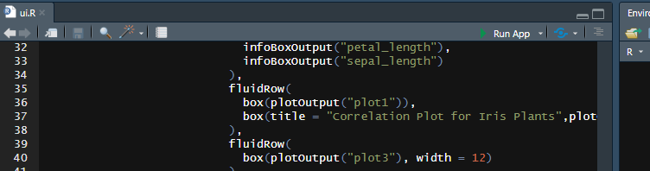
Publish the app with that Icon

Slide 24
Conclusion
R is indeed wonderful, as you can use it for a lot of tasks, especially tasks related to data analysis. Just in case you need the complete (and complex) freedom in which you control 100% of your environment, use a programming language such as R.

Slide 25
Thank You
Akwijoro Elijah Rona
Twitter: @Elijah_Rona
LinkedIn: Elijah Akwijoro
GitHub: elijahrona
Email: elijahakwijoro@gmail.com

